Slide 1
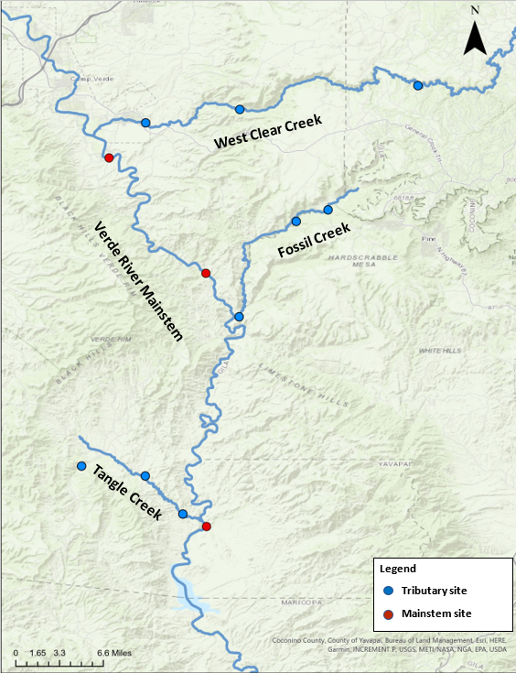
Project Summary: Preliminary data analysis on Verde River aquatic invertebrates
Main scientific question being addressed:
How are aquatic invertebrate communities of the Verde River shaped by their environment at different spatial and temporal scales?
Between microhabitats (flowing water vs pools)
Between sites (reaches)
Between tributaries and mainstem
Between seasons

Slide 2
Goals
Get organized, learn how GIT works:
File naming and folder structure
Cleaning up old code and implementing clear and consistent coding practices
Do some analyses and make them reproducible and easily altered
Ordinations showing community structure at different spatial scales
Measures of diversity at different spatial scales
Learn how to use R markdown and how it could benefit my project

Slide 3


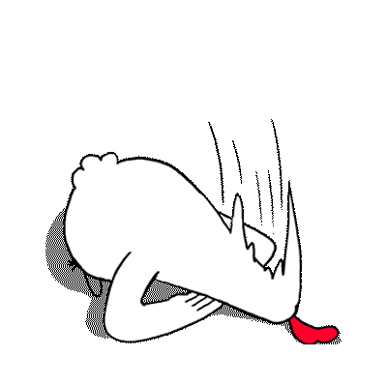
Achieved success
Get organized, learn how GIT works:
File naming and folder structure
Cleaning up old code and implementing clear and consistent coding practices
Do some analyses and make them reproducible and easily altered
Ordinations showing community structure at different spatial scales
Measures of diversity at different spatial scales
Learn how to use R markdown and how it could benefit my project

Slide 4
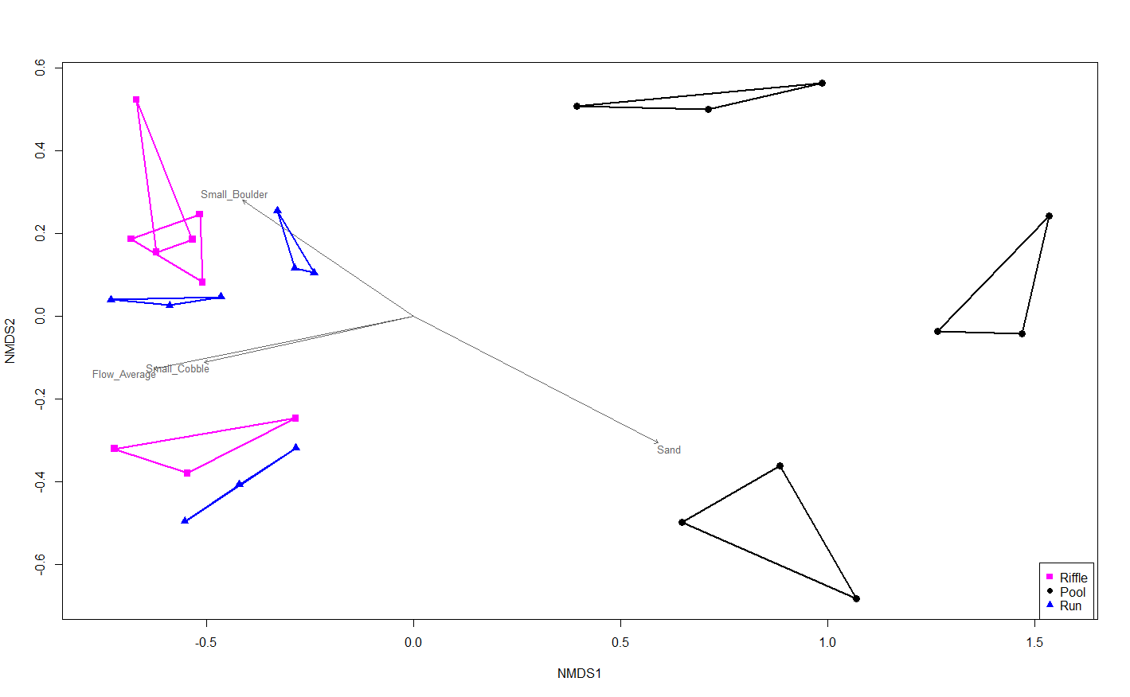
Scientific Insights- What did I find? How different are aquatic invertebrate communities of the Verde River between sites (river reaches) and microhabitats?
This NMDS ordination shows Verde River invertebrate samples from spring of 2018. Microhabitats are color coded and each site (which is a different river reach) is enclosed in a polygon. Significant environmental variables (p<0.05, R^2 > 0.5) are overlayed to show how the environment shaped community structure.
We can see clear separation of flowing (riffles and runs) and pool communities. Community differences for sites also seem important at this scale, with pools showing a stronger site effect.

Slide 5
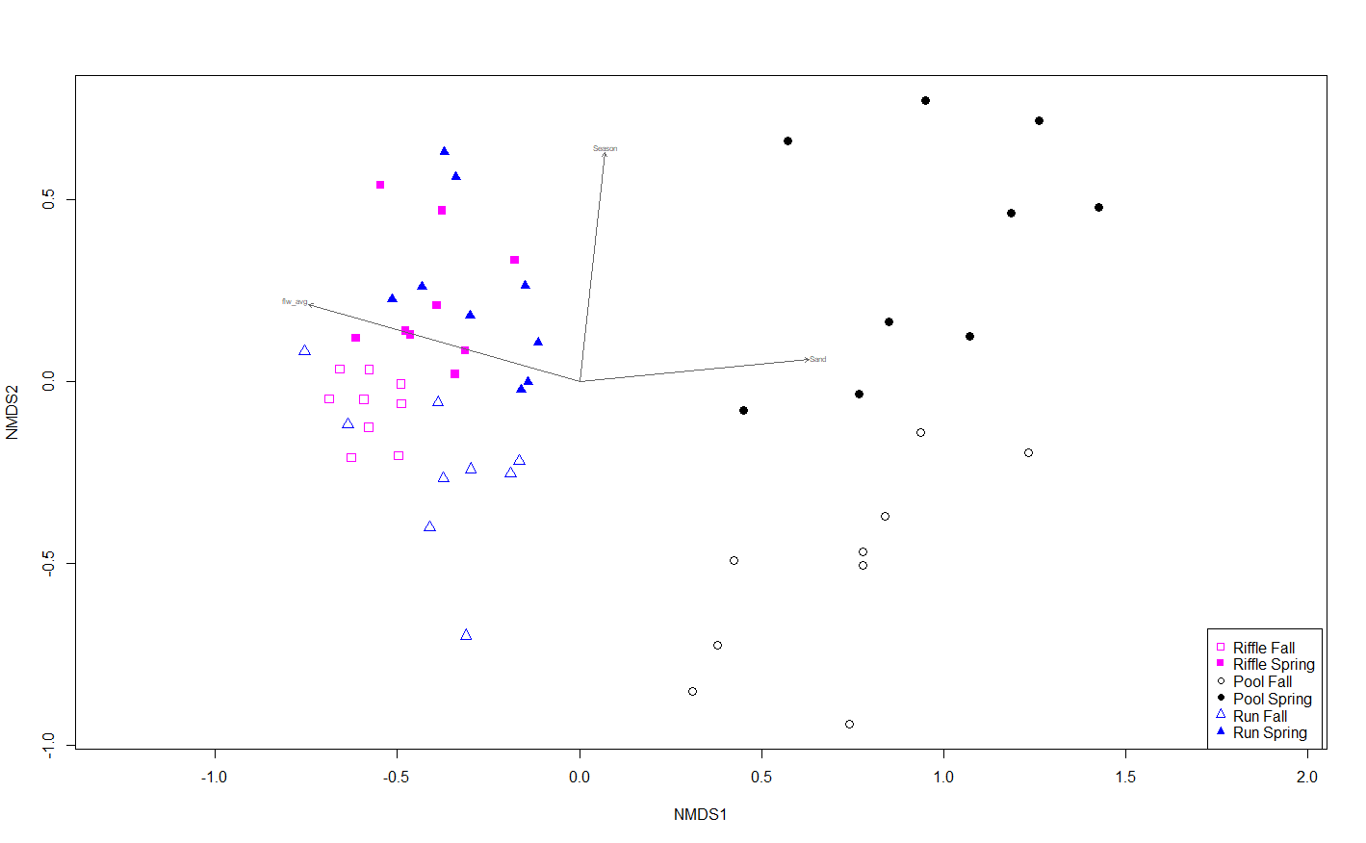
How different are aquatic invertebrate communities of the Verde River between microhabitats and seasons?
This NMDS ordination shows Verde River invertebrate samples from fall of 2017 and spring of 2018. Microhabitats are color coded, and each season is either open (fall) or closed (spring). Significant environmental variables (p<0.05, R^2 > 0.5) are overlayed to show how the environment shaped community structure.
We can see clear separation of flowing (riffles and runs) and pool communities. Seasonality is also showing a clear effect on community structure.

Slide 6
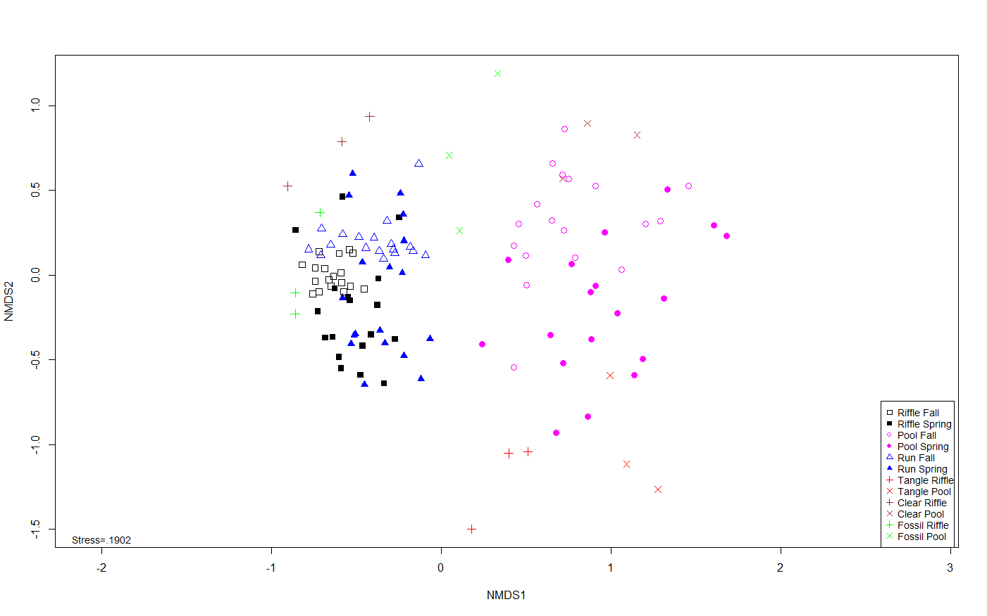
How different are aquatic invertebrate communities of the Verde River between microhabitats and seasons?
This NMDS ordination shows Verde River mainstem invertebrate samples from fall of 2017 to spring of 2019 (4 sampling events, n=108) and tributary samples from lower sites from fall of 2019 (n=6 for each tributary). Microhabitats are color coded, and each season is either open (fall) or closed (spring). Tributaries each have their own color and different shapes (+ are riffles and x are pools).
We can see clear separation of flowing (riffles and runs) and pool communities. Seasonal effects get a little muddy with an extra year of data. Tributary samples seem to be unique compared to each other and have varying similarity to mainstem samples.

Slide 7
Sticking points and future plans
Sticking points
GIT Hub file management, version control
Cleaning up code
Future plans
Finish sample processing (more data for tributaries)
Community analysis class next term (BOT 370) for some formal training on NMDS stuff
Dive into analyses next term

